Slide 1


FAC AIDS with invitro diagnostics
Sharonann Lynch, HIV Policy Lab @ Georgetown University
David Branigan, Treatment Action Group (TAG)
8 December 2021

Slide 2
Cryptococcal meningitis is an incredibly painful way to die.
Horrible headaches. Deafness. Blindness. Coma.
“Cerebral herniation" - basically the brain gets pushed down into the spinal canal due to increased intracranial pressure.
Survival
20% using monotherapy
70% WHO recommended treatment
Invisible
If it’s not measured, does it matter?
Cryptococcal meningitis – INCIDENCE?
Treatment coverage?
Deaths?

Slide 3
Diagnostics
CD4 count testing
Cryptococcal antigen (CrAg) RDT
TB lipoarabinomannan (LAM) tests
Early infant diagnosis (EID)
Routine Viral Load
https://msfaccess.org/20-tool-checklist-diagnosing-treating-and-preventing-aids

Slide 4
CD4 count
WHO designation as ESSENTIAL (2018)
Diagnosing AIDS/Advanced HIV disease (CD4<200 cells/μL)
Point of care (POC): critical gateway to managing AIDS/AHD
  Triggering package of care
PEPFAR supports its use: ART initiation, re-entry to care, monitoring
Why we need CD4 to diagnose AHD
1,805 ppl CD4 <100 | REALITY trial Kenya, Malawi, Uganda, Zim
CD4 37 cells/μL | Median CD4 count
Half (47.3%) | Asymptomatic
Symptoms alone are not enough for diagnosing AHD!
Hakim J et al. (2017) NEJM
Notes:
From WHO (2017 AHD GLs): The second trial (REALITY) enrolled 1805 mainly adults living with HIV with CD4 cell counts <100 cells/mm3 (median CD4 cell count was 36 cells/mm3 and half were classified as WHO clinical stage 1 or 2) from Kenya, Malawi, Uganda and Zimbabwe.
Source: Hakim J et al. (2017) Enhanced prophylaxis plus antiretroviral therapy for advanced HIV infection in Africa. NEJM 377:233-245. Link

Slide 5

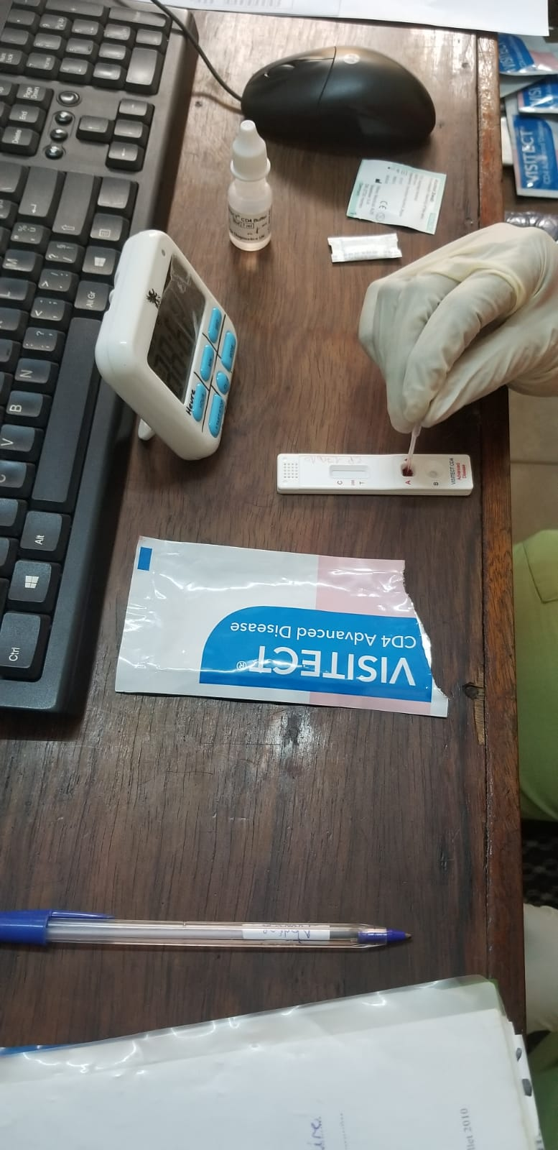
VISITECT CD4 Advanced Disease
US$3.98 a test
  Semi-quantitative POC RDT:
  whether CD4 is above
  or below CD4 200 cells/μL

Slide 6
Cryptococcal antigen lateral flow assay (CrAg LFA)
CrAg LFA= rapid point-of-care (POC) test to detects cryptococcal antigen (via venous or finger-prick)
WHO recommends
  CrAg screening for all PLHIV with CD4 <200 cells/mm3
  If Ag POSITIVE, receive pre-emptive fluconazole treatment to prevent development of CM
Rapid disease progression: CrAg+ diagnosis to CM in median time of 22 days
Source: https://dndi.org/wp-content/uploads/2021/05/EndCryptococcalMeningitisDeaths2030-StrategicFramework-EN-2021.pdf
https://pubmed.ncbi.nlm.nih.gov/11953469/
Notes:
https://pubmed.ncbi.nlm.nih.gov/11953469/

Slide 7
Cryptococcal antigen (CrAg) RDT
a) IMMY: US$2.00 a test
b) Biosynex: US$2.40 a test

Slide 8

TB lipoarabinomannan (LAM) tests
TB LAM tests are rapid point-of-care TB tests among PLHIV that are proven to be life-saving
WHO recommends rapid LAM testing among PLHIV who:
  have signs and symptoms of TB
  Or, are seriously ill
  Or, have AIDS/AHD: CD4 ≤200 cells/mm3 (inpatient) or CD4 ≤100 cells/mm3 (outpatient)
TB LAM tests use urine samples and return results in just 25 min
A recent systematic review found that:
  PLHIV receiving LAM testing in inpatient settings had a 15% lower risk of mortality, and
  LAM testing in outpatient settings may result in a large increase in the proportion of PLHIV started on TB treatment. (Nathavitharana et al, Cochrane Reviews, August 2021)
Every PLWHA in a hospital should receive a TB LAM test
Notes:
LAM tests are rapid point-of-care tests for TB among PLHIV that are proven to be life-saving. (Gupta-Wright et al, Lancet, July 2018)
WHO recommends rapid LAM testing in combination with rapid molecular testing (GeneXpert, Truenat) among PLHIV who:
have signs and symptoms of TB
are seriously ill
have AIDS/advanced HIV disease
LAM tests utilize urine – an easily obtainable sample – and return results in just 25 min.
A recent systematic review found that:
PLHIV who received LAM testing in inpatient settings had a 15% lower risk of mortality, and
the use of LAM testing in outpatient settings may result in a large increase in the proportion of PLHIV who were started on tuberculosis treatment. (Nathavitharana et al, Cochrane Reviews, August 2021)

Slide 9
TB lipoarabinomannan (LAM) tests
Slow uptake of LAM testing
62% (23/37) of countries did not have routine LAM testing policies (MSF & Stop TB Partnership Step Up for TB 2020 report)
TB LAM has regulatory approval in most high-burden countries, but national policies are lagging behind (see slides)
Number of countries buying TB LAM did not increase: 2018-2020 (18), according to Abbott
What to push for
All PLHIV with TB signs & symptoms, or severely ill, or with AHD to receive a rapid LAM test (and confirmatory rapid molecular testing: GeneXpert, Truenat)
TB treatment immediately started following LAM-positive result
Adequate quantities procured
Abbott’s Determine TB LAM Ag
US$3.70 per test
(in packs of 25)
Notes:
LAM testing was recommended by WHO in 2015 and again in 2019.
According to the MSF & Stop TB Partnership Step Up for TB 2020 report, in 2020 62% (23/37) of countries surveyed did not indicate LAM testing in their policies for routine use
LF-LAM has regulatory approval in most countries with high burdens of TB and HIV, but national policies are lagging behind. (see additional slides)
According to data from Abbott, the manufacturer of Determine TB LAM, the number of countries that procured the LAM test from the company did not increase between 2018 and 2020 (18 countries). (see additional slides)
The currently available LAM test, Determine TB LAM Ag from Abbott, costs only US$3.70 per test (in packs of 25) and is available from the Global Drug Facility diagnostics catalogue.

Slide 10
TB lipoarabinomannan (LAM) tests
PEPFAR Country Operational Plan (COP) inclusion of LAM testing - 2018-2021
 | LAM in 2018 COP? | LAM in 2019 COP? | LAM in 2020 COP? | LAM in 2021 COP?
Cote d’Ivoire | Y | Y | Y | Y
Democratic Republic of the Congo | Y | Y | Y | Y
Eswatini | Y | Y | Y | Y
Kenya | Y | Y | Y | Y
Malawi | Y | Y | Y | Y
Zambia | Y | Y | Y | Y
Lesotho | N | Y | Y | Y
Namibia | N | Y | Y | Y
South Africa | N | Y | Y | Y
Tanzania | N | Y | Y | N
Uganda | N | Y | Y | Y
Ukraine | N | Y | Y | Y
Botswana | N | N | Y | Y
Brazil | N | N | Y | Y
India | N | N | Y | Y
Mozambique | N | N | Y | Y
Nigeria | N | N | Y | Y
South Sudan | N | N | Y | Y
Zimbabwe | N | N | Y | Y
Ethiopia | N | N | N | Y
Haiti | N | N | N | Y
Trinidad & Tobago | N | N | N | Y
Vietnam | N | N | N | Y
TOTALS | 6 | 12 | 19 | 22

Slide 11
Thank you
Sharonann Lynch, HIV Policy Lab, Georgetown University
sl1903@georgetown.edu
David Branigan @ TAG
david.branigan@treatmentactiongroup.org
Resources
HIV Policy Lab. www.hivpolicylab.org
MSF. 20-tool checklist for diagnosing, treating and preventing AIDS. https://msfaccess.org/20-tool-checklist-diagnosing-treating-and-preventing-aids
Strategic framework to end CM deaths: https://dndi.org/wp-content/uploads/2021/05/EndCryptococcalMeningitisDeaths2030-StrategicFramework-EN-2021.pdf
TAG’s An Activist’s Guide to the LAM Test: https://www.treatmentactiongroup.org/publication/an-activists-guide-to-the-tb-lam-test/
MSF and Stop TB Partnership’s Step Up for TB 2020 report: https://www.msf.org/step-tb-report-2020
Cochrane Review on the impact of TB LAM: https://www.cochranelibrary.com/cdsr/doi/10.1002/14651858.CD014641/full
Global Laboratory Initiative LAM test implementation guide: http://stoptb.org/wg/gli/assets/documents/practical-implementation-lf-lam.pdf
PEPFAR COP Strategic Direction Summaries: https://www.state.gov/where-we-work-pepfar/

Slide 12
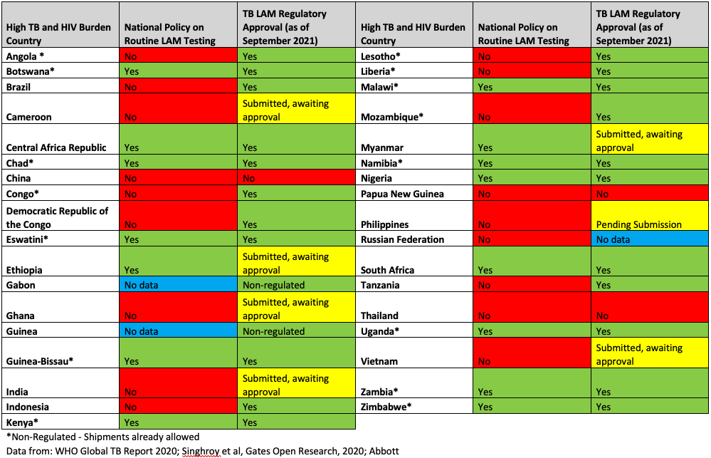
Additional Slides (1/2): LAM National Policies compared to Regulatory Approval

Slide 13
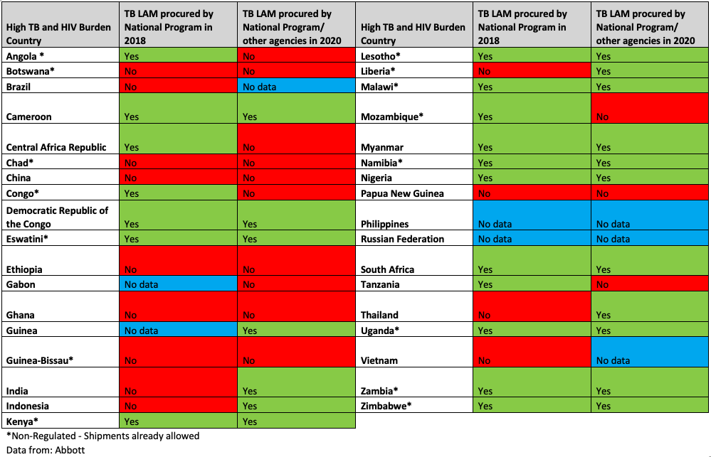
Additional Slides (2/2): LAM Procurement in 2018 compared to 2020

